Slide 1
Loan DelinquencyPrediction

Slide 2
PROBLEM STATEMENT
Loan default prediction is one of the most critical and crucial problem faced by financial institutions and organizations as it has a noteworthy effect on the profitability of these institutions. In recent years, there is a tremendous increase in the volume of non – performing loans which results in a jeopardizing effect on the growth of these institutions.
Therefore, to maintain a healthy portfolio, the banks put stringent monitoring and evaluation measures in place to ensure timely repayment of loans by borrowers. Despite these measures, a major proportion of loans become delinquent. Delinquency occurs when a borrower misses a payment against his/her loan.
Given the information like mortgage details, borrowers related details and payment details, our objective is to identify the delinquency status of loans for the next month given the delinquency status for the previous 12 months (in number of months)
Target Variable : m13

Slide 3
01
Data Wrangling
Cleaning the raw data and making it useful for further analysis.
02
Data Exploration
Gaining insights from the data to find correlated features.
03
ML Model Implementation & Selection
Trying different ML models & selecting the best performing model.
04
Our
Approach
Implementation on Data
Understanding the Best Model to Implement on the Test Data

Slide 4
Approached Models and Evaluation Scores
Random Forest Regressor
F1 Score using Random Forest Regressor: 1

Slide 5
Structure of the Dataset
Test Data: (23212,29)
Training Data: (92846, 30)
No Missing Value Present in the Dataset

Slide 6
Attributes of the Dataset
average_runtime(minutes_per_week)
UserID
Unique id for each row.
Minutes per week the advertisement was aired
ratings
Metric out of 1 which represents how much of the targeted demographic watched the advertisement
targeted_sex
Sex that was mainly targeted for the advertisement
airlocation
genre
Country of origin
The type of advertisement
relationship_status
The relationship status of the most responsive customers to the advertisement.
industry
The industry to which the product belonged.
money_back_guarantee
expensive
airtime
A general measure of how expensive the product or service is that the ad is discussing
Time when the advertisement was aired.

Slide 7
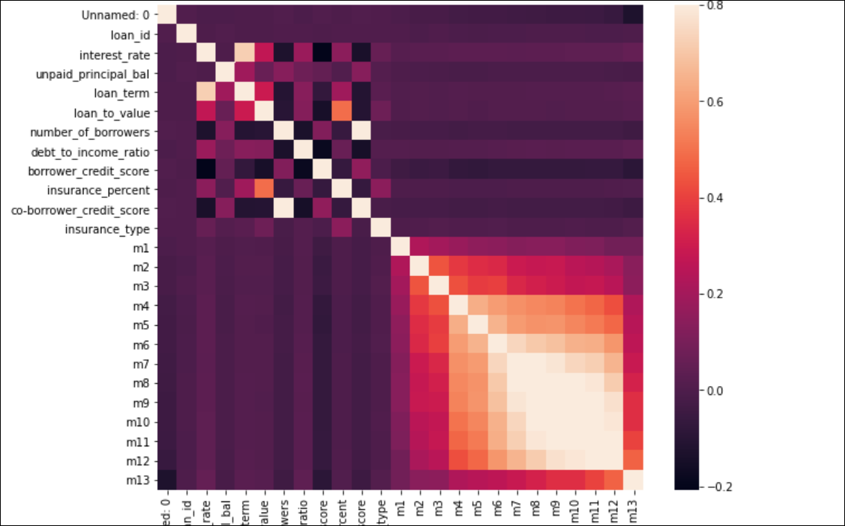
Exploratory Data Analysis
Correlation Matrix

Slide 8
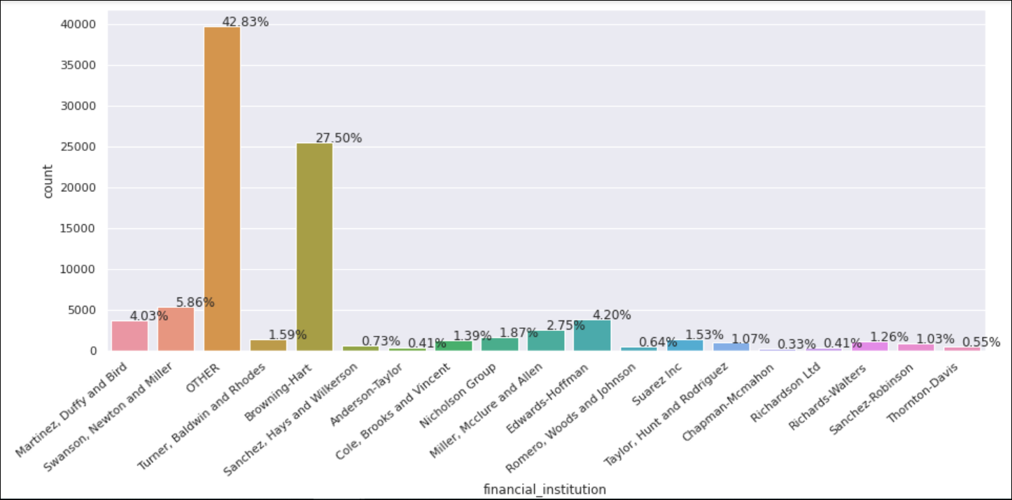
Exploratory Data Analysis
Data Distribution for Financial Institutions

Slide 9
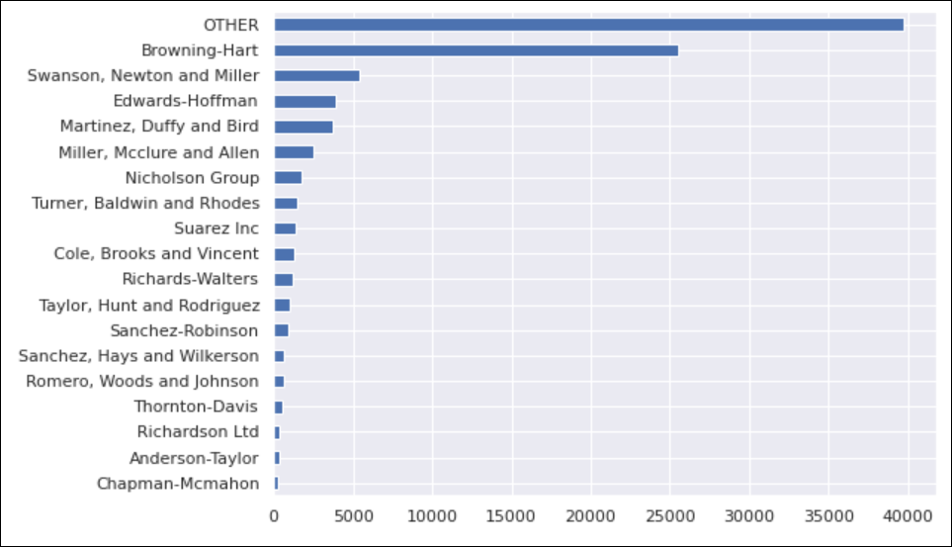
Exploratory Data Analysis
Other is mostly the Financial Institution

Slide 10
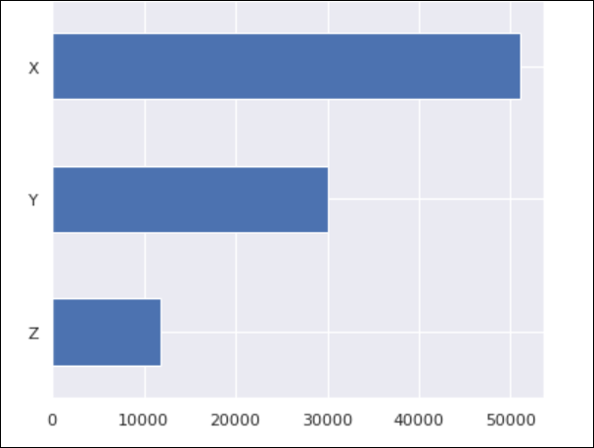
Exploratory Data Analysis
Mostly Source is X

Slide 11
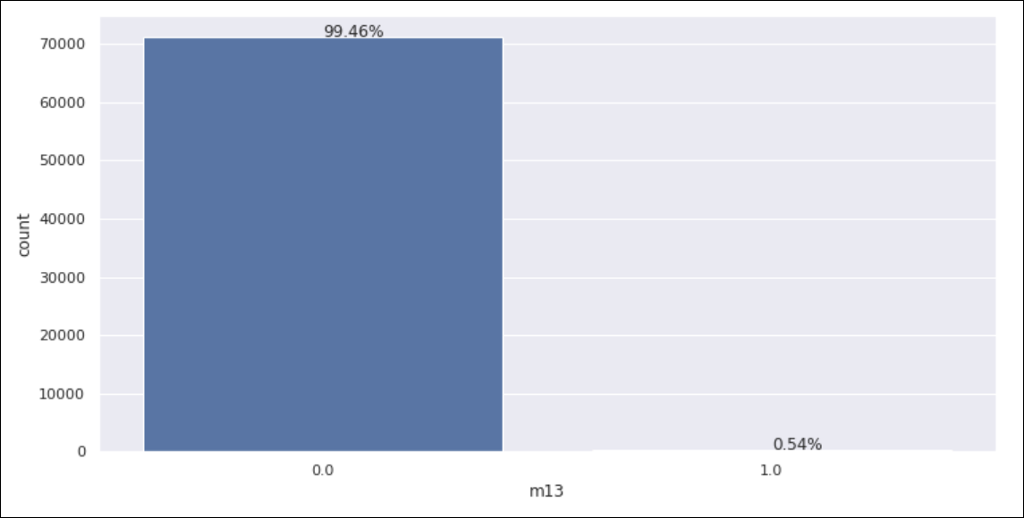
Exploratory Data Analysis
Clearly there is a Class Imbalance

Slide 12
Model Selection
Random Forest Classifier
Random forests is a supervised learning algorithm. It can be used both for classification and regression. It is also the most flexible and easy to use algorithm. A forest is comprised of trees. It is said that the more trees it has, the more robust a forest is. Random forests creates decision trees on randomly selected data samples, gets prediction from each tree and selects the best solution by means of voting. It also provides a pretty good indicator of the feature importance.
Label Encoder used to convert Categorical Data into
SMOTE is used to Impute Class Imbalance
Random Forest Classifier model is to Predict the targeted variable on the test variable

